Slide 1
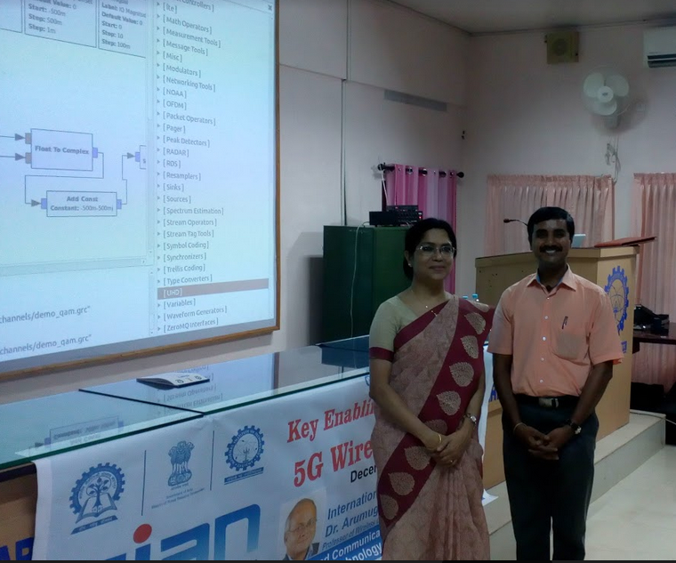
Dr. Gandhiraj, ECE/CEN faculty gave a talk on GNUradio and applications

